Slide 1
LabVIEW For Advanced Applications
Nancy Hollenback – NI Field Architect
Certified LabVIEW Architect

Slide 2
LabVIEW for Advanced Applications
Agenda
Definition of advanced apps
Pitfalls of advanced apps
10 keys for successful advanced apps in LabVIEW
Observations from the field!!

Slide 3
Defining Advanced Applications & LabVIEW Ability
Advanced Application
Advanced Application
Multi-
Target
Apps
3-Icon
Apps
State
Machines
Parallel
Apps
Effort
Ability

Slide 4
Pitfalls of Advanced Applications – Increased Likelihood to Incur Software Engineering Debt (just some of the most common LabVIEW development mistakes)
No source code control (or Project)
Flat file hierarchy
‘Stop’ isn’t tested regularly
Wait until the ‘end’ of a project to build an application
Few specifications / documentation / requirements
No ‘buddying’ or code reviews
Poor planning or design
No test plans
Poor error handling
No consistent style
Tight coupling, poor cohesion
Notes:
The point of this slide is to get the audience to do a reality check regarding the level of sophistication of their own development practices. Keep in mind that it is in the introduction of other presentations, but in this case it serves as a preface to a discussion on architectures. That is why the ‘Lack of SMoRES’ bullet is highlighted, as it will be the stepping-stone for today’s discussion.
Lets start by looking at some of the most common mistakes. These are all common examples that can lead to the duct-tape and hot-glue diagram like the one we just saw. As engineers, we all appreciate the cost of cutting-corners or taking a short-cut… it may get us there sooner, but at what cost? In the world of software, there’s a concept known as ‘Software Engineering Debt.’ If we cut corners, we take on more debt, and these are all examples of how we do that. The more debt we take on, the more interest we accumulate over time, and as we’ve all seen in the recent years, that debt can quickly pile up and accumulate a mountain of interest, making it more expense the longer we wait. If we wait to pay down that debt until after we release a version of the software to our customer, it’s going to painful and the bugs will be much more costly than if we’d caught them up front.
The practices we’ll look at in this presentation will help address most, if not all of these, but do want to mention a few right now. (I recommend picking a few to really emphasize… here is some additional information on each to allow you to decide
No source code control (or Project) – if you’re not using it, you’re playing with fire. Even for a small project with one developer, these tools can save you a tremendous amount of time and heartache.
Flat file hierarchy – ever had trouble identifying the top-level VI in an application? It’s not just an organizational problem, it indicates a lack of encapsulation and proper design. Use folders, encapsulate your code and make APIs obvious from private subVIs
‘Stop’ isn’t tested regularly – there are lots of ways to assess the health of an application, but this is an easy one that you should always be thinking about. A new feature is no good if it impedes expected behavior and one key indicator is whether or not the application still stops instantly when asked to
Wait until the ‘end’ of a project to build an application – if you’re one of those that waited until you were ‘done’ to build an exe for the first time, you’re probably a long ways away from done. The reality is that, as with any language, a lot of things change in the RTE, and you need to test this on a regular basis
Few specifications / documentation / requirements – this is perhaps the most common mistake and the easiest way to ensure that code is not reusable or maintainable
No ‘buddying’ or code reviews – sometimes the mere act of explaining your code to someone else finds major problems or bugs… do it, and do it often
Poor planning (Lack of consideration for SMoRES) – This acronym stands for ‘Scalable,’ ‘Modular,’ ‘Reusable,’ ‘Extensible,’ and ‘Simple.’
No test plans – you can’t test code if you don’t define how it should behave.
Poor error handling – does it stop? Does it tell the user an error? Does it log the error? If you don’t plan for this early, a simple error can lead to even more problems
No consistent style = not readible, not maintainable
Tight coupling, poor cohesion – impedes reuse
A lot of us are under pressure to get things done quickly and to hit aggressive deadlines, but there are a few practices that if we invest in early, will pay dividends down the road.
Any are all of these are topics I’m happy to talk about in-depth. In fact, if you’re interested, we can arrange a presentation for you and your colleagues on any of these that you're interested in.

Slide 5
LabVIEW and The Software Engineering Process
Requirements Gathering
Application Architecture
Development
Testing and Validation
Deployment
NI Requirements Gateway
Design Patterns and Ref. Arch.
Graphical Diff
Now Included with DevSuite
LabVIEW Unit Test Framework
Application Builder
SCC
Object Oriented
LabVIEW
VI Analyzer
Real Time/FPGA
Documentation
VIPM
Architecture/Design Review
Coding Standards
LabVIEW Desktop Execution Trace
Notes:
Point of this slide
We understand software engineering and we have tools to help
This is a simplified depiction of the software engineering process (there are a bunch!)
People are successful in this process without these tools – they exist to improve and automate existing practices
A process model prescribes specific phases and tasks to accomplish during the development process. While there are many representations of the software engineering ‘process,’ including the waterfall model, the spiral process model, or more contemporary models such as agile or XP (extreme programming) models, perhaps one of the most common and rigorous, the ‘v-model.’
If you look closely at this diagram you’ll notice that it begins with the defining of requirements for the product. These are often high level and are often developed through discussion with the customer or end-user.
One thing to realize is that the level of criticality directly impacts how granular you have to be in this process. You may not need to spend any formal time architecting your application or the specific modules of code, but these are typically very important for large, complex systems.
There are several SEP models, such as Waterfall, Spiral and Agile, but they all share common ground in terms of having these various phases and tasks that have to be completed. Many companies today are leaning more towards increasingly agile methods. Basically, this means that for many it’s unrealistic to abide by a waterfall method, in which you work on a particular phase, then agree that you’re done and move on. In reality, complex applications require a lot of back and forth between these different phases. For example, something in the prototype stage doesn’t work as expected and therefore require a new definition for how a particular part of the application will operate, thereby impacting requirements documentation and other components such as the test framework. We’ll look at how to address some of these common challenges in just a few slides..
You might note that this does not include prototyping, which is an important part of the development process, but not included in this discussion. For many software vendors, prototyping has very close ties to the requirements phase, as the prototyping lends itself towards a better understanding of what the final product will do. We’ll discuss that further when we talk about requirements management.

Slide 6
10 Keys to Successful LabVIEW Programming for Large Applications
Utilize the Project for your Team
Automate Aspects of the Software Development Process
Design Your Application First
Customize Templates from Standard Design Patterns
Leverage Standard Design Patterns
Harness the Power of Object Oriented Programming
Engage in Code Reviews
Perform Dynamic Code Analysis
Ensure App is Regularly Tested by Someone Else
Participate in Local and Global Community
Notes:
Note that these are beneficial for any size application

Slide 7
LabVIEW and The Software Engineering Process
Requirements Gathering
Application Architecture
Development
Testing and Validation
Deployment
NI Requirements Gateway
Design Patterns and Ref. Arch.
Graphical Diff
Now Included with DevSuite
LabVIEW Unit Test Framework
Application Builder
SCC
Object Orientation
LabVIEW
VI Analyzer
Real Time/FPGA
Documentation
VIPM
Architecture Review
Coding Standards
LabVIEW Desktop Execution Trace
Notes:
Point of this slide
We understand software engineering and we have tools to help
This is a simplified depiction of the software engineering process (there are a bunch!)
People are successful in this process without these tools – they exist to improve and automate existing practices
A process model prescribes specific phases and tasks to accomplish during the development process. While there are many representations of the software engineering ‘process,’ including the waterfall model, the spiral process model, or more contemporary models such as agile or XP (extreme programming) models, perhaps one of the most common and rigorous, the ‘v-model.’
If you look closely at this diagram you’ll notice that it begins with the defining of requirements for the product. These are often high level and are often developed through discussion with the customer or end-user.
One thing to realize is that the level of criticality directly impacts how granular you have to be in this process. You may not need to spend any formal time architecting your application or the specific modules of code, but these are typically very important for large, complex systems.
There are several SEP models, such as Waterfall, Spiral and Agile, but they all share common ground in terms of having these various phases and tasks that have to be completed. Many companies today are leaning more towards increasingly agile methods. Basically, this means that for many it’s unrealistic to abide by a waterfall method, in which you work on a particular phase, then agree that you’re done and move on. In reality, complex applications require a lot of back and forth between these different phases. For example, something in the prototype stage doesn’t work as expected and therefore require a new definition for how a particular part of the application will operate, thereby impacting requirements documentation and other components such as the test framework. We’ll look at how to address some of these common challenges in just a few slides..
You might note that this does not include prototyping, which is an important part of the development process, but not included in this discussion. For many software vendors, prototyping has very close ties to the requirements phase, as the prototyping lends itself towards a better understanding of what the final product will do. We’ll discuss that further when we talk about requirements management.

Slide 8
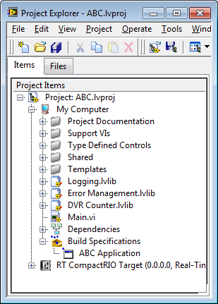
#1 - Strategic Use of the Project
This “target” refers to the main
Windows computer.
Other “targets” may be a part of the system.

Slide 9
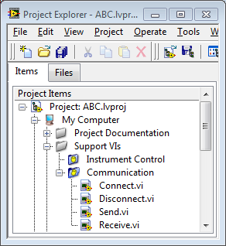
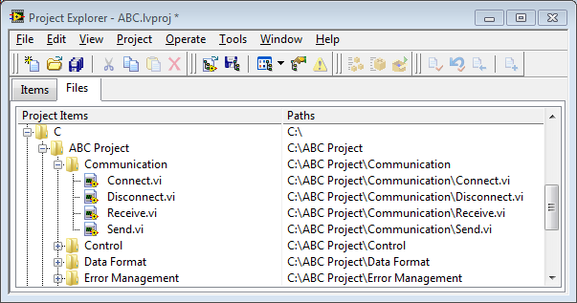
Project Explorer Window
Items page
Files page
Notes:
The Project Explorer window includes two pages, the Items page and the Files page. The Items page displays the project items as they exist in the project tree. The Files page displays the project items that have a corresponding file on disk. You can organize filenames and folders on this page. Project operations on the Files page both reflect and update the contents on disk. You can switch from one page to the other by right-clicking a folder or item under a target and selecting Show in Items View or Show in Files View from the shortcut menu.

Slide 10
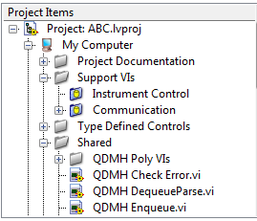
Using Project Folders
Virtual folder
Organizes project items and does not represent files on disk
Auto-populating folder
Adds a directory on disk to the project
LabVIEW continuously monitors and updates the folder according to changes made in the project and on disk
Notes:
Adding Folders to a Project
Use the Project Explorer window to add folders to create an organizational structure for items in a LabVIEW project.
Adding auto-populated folders adds a directory on disk to the project. LabVIEW continuously monitors and updates the folder according to changes made in the project and on disk. A blue folder icon with a yellow cylinder identifies this type of folder. To disconnect an auto-populated folder from disk, right-click the auto-populated folder on the Items page and select Stop Auto-populating from the shortcut menu. LabVIEW disconnects the folder from the corresponding folder on disk. This option is available only to top-level folders and applies recursively to subfolders of auto-populated folders.
A virtual folder organizes project items and does not represent files on disk. A silver folder icon identifies this type of folder. You can convert a virtual folder to an auto-populated folder. Right-click the virtual folder and select Convert to Auto-populating Folder to display a file dialog box. Select a folder on disk to auto-populate. An auto-populated folder appears in the project.
LabVIEW automatically renames the virtual folder to match the disk folder and adds all contents of the disk folder to the project. If items in the directory already exist in the project, the items move within the auto-populated folder. Items in the virtual folder that do not exist in the directory on disk move to the target.

Slide 11
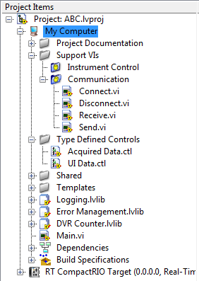
The Project Is A Workspace For Organizing Files
Include project documentation.
Organize subVIs and controls, placing them in virtual or auto-populating folders.
Clearly label Main VIs and leave them at the top level of the project.

Slide 12
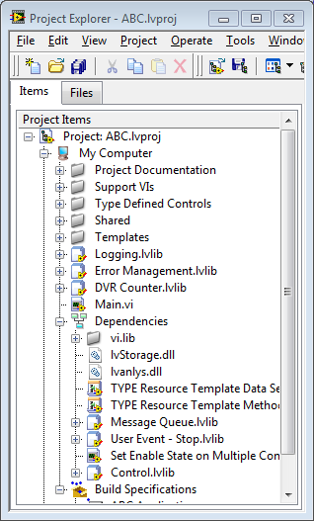
Project Dependencies
Select Dependencies to open the list of subVIs that VIs under a given target require.
Identify VIs and libraries that are used by other VIs in the project
Notes:
Use Dependencies to view items that VIs under a target require. Each target in a LabVIEW Project includes Dependencies. Dependencies lists the VI hierarchies of all VIs in the project.
You cannot add items directly to Dependencies. Dependencies updates automatically when you add, remove, or save an item in the project. For example, if you add a VI that includes a subVI to a target, LabVIEW adds the subVI to Dependencies. However, if you add a dependent item under a target, the item does not appear under Dependencies. For example, if you add the VI and the subVI under the target, LabVIEW does not add the subVI under Dependencies. You can right-click Dependencies and select Refresh from the shortcut menu to view the current dependencies.

Slide 13
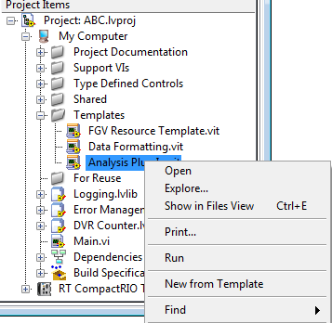
Conveniently Locate Project Templates
Facilitate the development of code modules from vetted templates based on common design patterns or defined project interfaces.

Slide 14
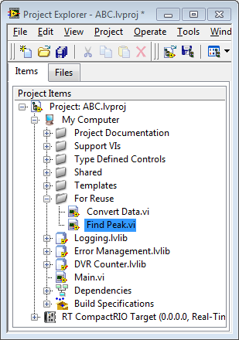
Catch Code For Reuse
Define a space in the project for locating VIs that could potentially be rolled into reuse libraries.

Slide 15
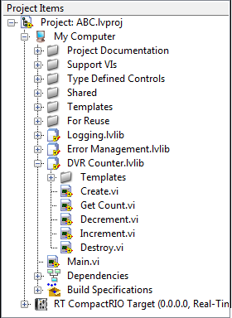
Project Libraries
Consider distributing code modules as a project library. Each VI is uniquely owned by the lvlib.

Slide 16
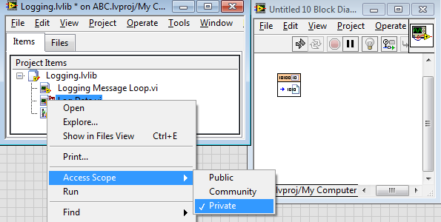

Project Libraries – Access Scope
Private VIs can only be called by other VIs in a library.
Provide a public interface for VIs that will be used by the main application.
Protect code that may change by making the VI private.
Notes:
Start with some common code. Login Screen, Display… As incorporate into a new project, name spacing

Slide 17
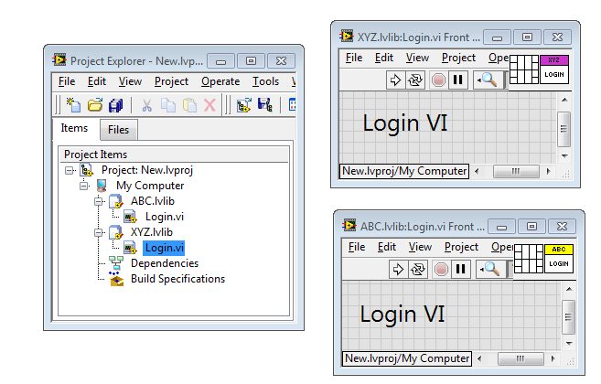
Project Libraries – Name Spacing
The name of the VI, when it is in the LabVIEW environment, contains the library name as well. As such, two different VIs with the same name can be in memory at the same time.

Slide 18
Caveats and Guidelines
Remember that the .lvlib is an xml file, but Vis cannot be added by editing the xml file
Move and rename VIs from the Project Explorer
Decide how to structure .lvproj and .lvlib for team development and effective SCC
In general, keep all VIs and the associated .lvlib in the same folder on the drive
Have a separate .lvproj for each .lvlib
Each development team should explore options for organizing the project and establish standards

Slide 19
#2 - Automate Aspects of the Software Development Process
Master VI Server
Create templates for design documents, code reviews and test plans
Start simple adding and add few steps to your existing work flow

Slide 20
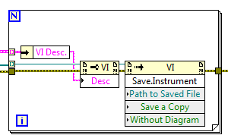
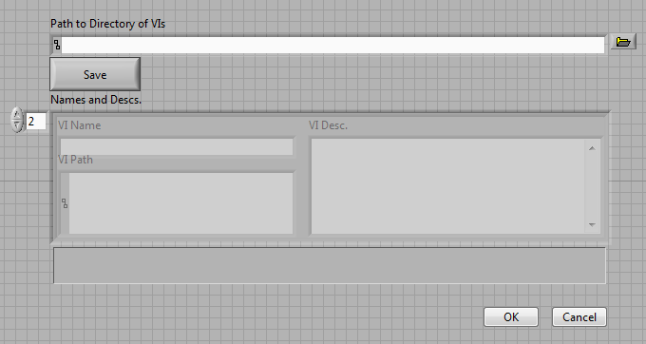
Leverage VI Server for Code Documentation Tools

Slide 21
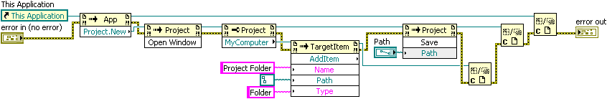
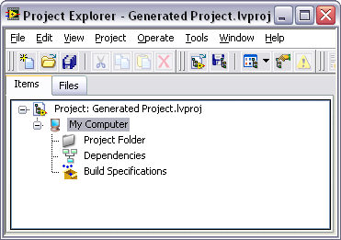
Project API – Create Tools
Example: Create a project with a folder and save the project
Notes:
This example creates a project file with a single folder called Project Folder. The project is saved, specified by the value of the Path control. The first step is to instantiate a new project using the New method of the Project class. After you instantiate the project, you can open the window and access the My Computer root of the project. Every copy of LabVIEW has the My Computer root as a target. When you have a reference to the My Computer root, you can use the AddItem method to add files, folders, or VIs to the Project. After you create the Project Folder, you can save the project using the Save method of the Project class. The Close Reference function then cleans up the references.
Tip: You can learn how to use the properties and methods of various Project classes by first interacting with the Project and viewing the resulting XML code. This shows you the types of parameters that are passed to the properties and methods using the VI Server.

Slide 22
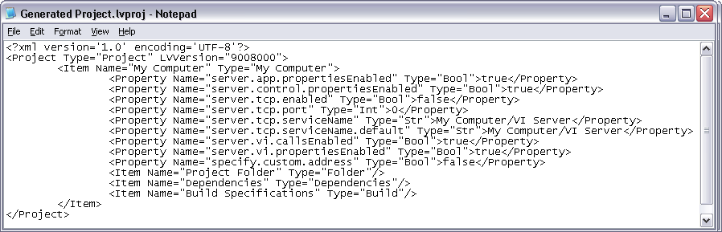
Project API – Create Project Example XML File
Notes:
From the example, you can see that the resulting XML file contains the Item tag with the parameters passed to the AddItem method.

Slide 23
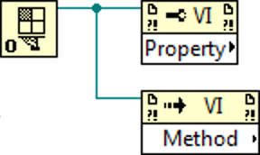

Scripting Overview
Scripting is exposed through VI Server
Notes:
Scripting is exposed to you through the same construct as VI Server. I’m assuming previous familiarity with VI Server…if you don’t have that familiarity, the really really short version is:
-click-
You acquire a reference to something, then act on that reference with property and invoke nodes. These nodes have pop-out lists with a list of the options for that type of reference.
-click-
You use the close references function to signal that you are done with those references. LabVIEW gets slow if you have a lot of references open at the same time.

Slide 24
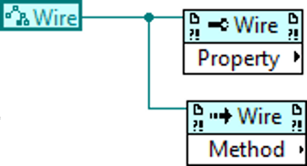
Scripting Overview
Scripting activates additional parts of VI Server
New Reference Types
New Properties
New Methods
Notes:
Scripting exposes a number of new reference types, properties, and methods.
If you are using a function, type, property or method which is only available because you turned on scripting, LabVIEW tints it blue to signal to you that it’s different than the stock items in LabVIEW.

Slide 25
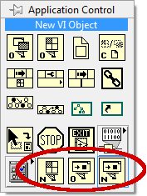
Scripting Overview
Scripting exposes new functions
New VI
New VI Object
Open VI Object Reference
Notes:
Scripting also exposed a number of new functions on the application control palette. We’ll talk about these in detail in just a moment.

Slide 26
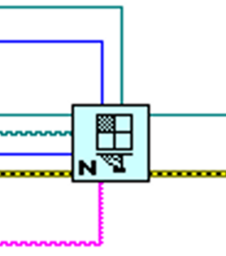
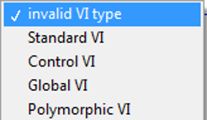
Scripting Overview
Scripting 101: New VI
New VI
vi type
Notes:
One of the fundamental things you can do in Scripting is to create a new blank VI. You do this with the ‘New VI’ function.
VI

Slide 27
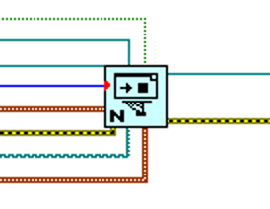
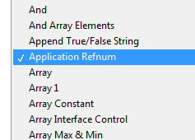
Scripting Overview
Scripting 102: New object
New VI Object
vi object class
owner refnum
object refnum
style
path
Notes:
Another fundamental thing you can do is create a new object on a VI’s block diagram or front panel. You do this with the New VI Object function.
If you want to drop one of the built in element types, you provide an argument to the ‘style’ terminal. This accepts a giant enumeration which contains an alphabetized list of every single object in LabVIEW.
-click-
If you want to drop something else, like a user defined type-def, or a call to a SubVI,you provide a path denoting the location where that element is saved on disk.
I want to make a big deal about that, because we find that lots of people have difficulty figuring out how to drop a SubVI. Let me say that again: You drop a SubVI call by using the New VI Object function with a path to the SubVI you want to call.
-click-
You’ll need to provide a reference to the thing that you want to hold the new object, through the owner refnum argument. This can be a VI reference, or a reference to the specific panel or diagram inside the VI. We’ll talk more about those specific reference types in a bit.
-click-
This primitive emits a reference to the newly created object. The type of the object refnum wire is set by wiring something to the ‘vi object class wire’. The value of your connected data doesn’t matter, only the type.
Like the previous function, if you wire the wrong type to ‘vi object class’ for what you tried to create, you’ll get an error at runtime. Be careful.

Slide 28
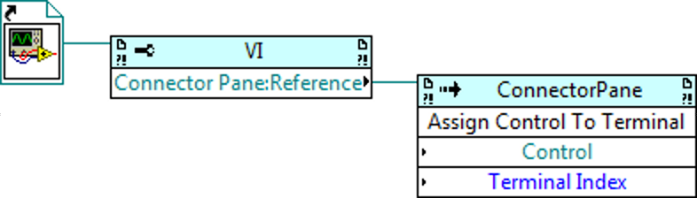
Scripting Overview
Scripting 103: Add Control To Connector Pane
Notes:
You can use an invoke node to connect a control from the front panel to a terminal on the connector pane, with a method named ‘Assign Control To Terminal’

Slide 29
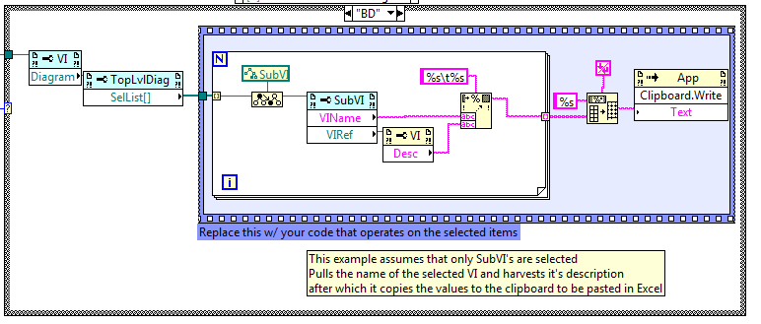
Get Started with Scripting Springboard
Found at the LabVIEW APIs Community

Slide 30
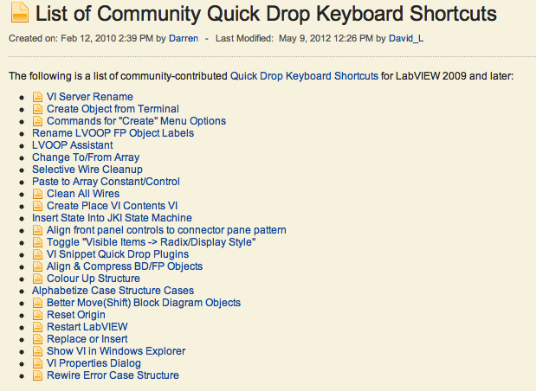
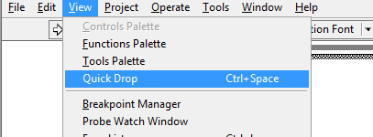
Quick Drop – Powered by VI Scripting
From the Quick Drop Enthusiast community page.

Slide 31
LabVIEW and The Software Engineering Process
Requirements Gathering
Application Architecture
Development
Testing and Validation
Deployment
NI Requirements Gateway
Design Patterns and Ref. Arch.
Graphical Diff
Now Included with DevSuite
LabVIEW Unit Test Framework
Application Builder
SCC
Object Orientation
LabVIEW
VI Analyzer
Real Time/FPGA
Documentation
VIPM
Architecture Review
Coding Standards
LabVIEW Desktop Execution Trace
Notes:
Point of this slide
We understand software engineering and we have tools to help
This is a simplified depiction of the software engineering process (there are a bunch!)
People are successful in this process without these tools – they exist to improve and automate existing practices
A process model prescribes specific phases and tasks to accomplish during the development process. While there are many representations of the software engineering ‘process,’ including the waterfall model, the spiral process model, or more contemporary models such as agile or XP (extreme programming) models, perhaps one of the most common and rigorous, the ‘v-model.’
If you look closely at this diagram you’ll notice that it begins with the defining of requirements for the product. These are often high level and are often developed through discussion with the customer or end-user.
One thing to realize is that the level of criticality directly impacts how granular you have to be in this process. You may not need to spend any formal time architecting your application or the specific modules of code, but these are typically very important for large, complex systems.
There are several SEP models, such as Waterfall, Spiral and Agile, but they all share common ground in terms of having these various phases and tasks that have to be completed. Many companies today are leaning more towards increasingly agile methods. Basically, this means that for many it’s unrealistic to abide by a waterfall method, in which you work on a particular phase, then agree that you’re done and move on. In reality, complex applications require a lot of back and forth between these different phases. For example, something in the prototype stage doesn’t work as expected and therefore require a new definition for how a particular part of the application will operate, thereby impacting requirements documentation and other components such as the test framework. We’ll look at how to address some of these common challenges in just a few slides..
You might note that this does not include prototyping, which is an important part of the development process, but not included in this discussion. For many software vendors, prototyping has very close ties to the requirements phase, as the prototyping lends itself towards a better understanding of what the final product will do. We’ll discuss that further when we talk about requirements management.

Slide 32
#3 – Design Your Application First
One of the strengths for LabVIEW is that it excels for rapid prototyping. With tight deadlines, some developers skip this critical step.
Design documents may include:
Diagrams (flow charts, variety of UML diagrams)
Documents (word, spreadsheet)
Prototypes
This is the Achilles heel of LabVIEW!!!

Slide 33
What is the Unique Problem To Solve?

Slide 34
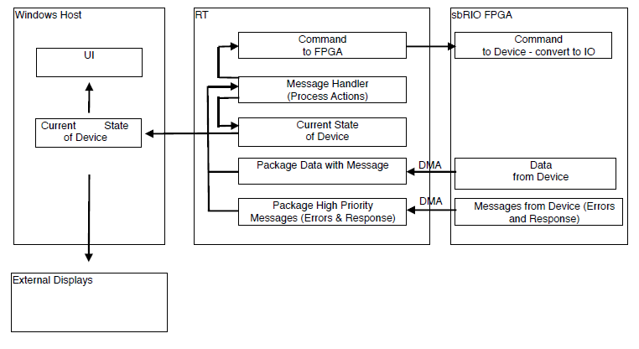
Design of a Medium Scale Real-Time Application
Each block or process will map to a design pattern in LabVIEW.
The architect must define communication mechanisms and integration test plan.

Slide 35
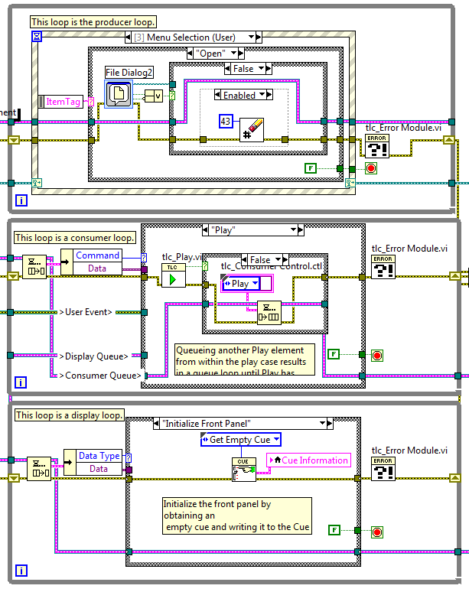
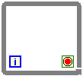
Processes Map to Queued Message Handlers
Message
Process
Data
Process
Display
Process

Slide 36
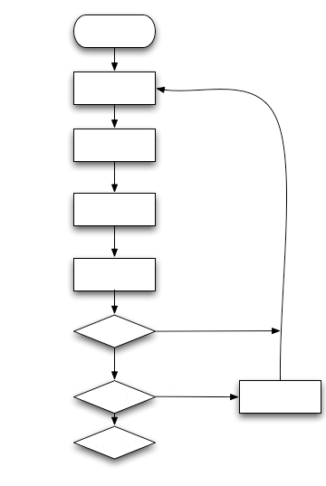
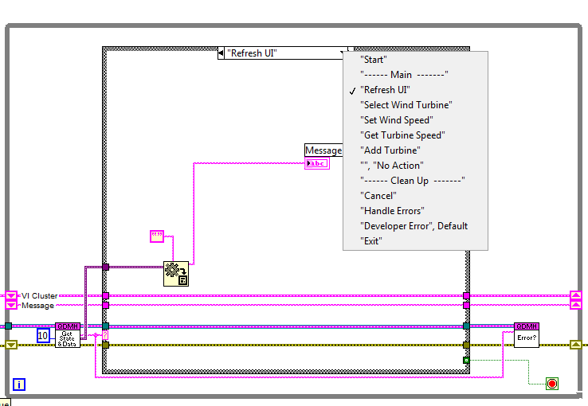
Flow Charts Map to States of a Queued Message Handler
Start
Refresh UI
Select Wind
Turbine
Set Wind
Speed
Get Turbine Speed
Add
Turbine?
Yes
Error?
Yes
Handle Errors
Continue?
Update the flow chart as requirements change.
Notes:
Potential Flow Chart for Parts of the Wind Farm
Flow charts form an integral part of defining the sequential aspects of an application. You can easily map a flow chart to a Queue Driven Message Handler (or State Machine). Each step, or action or verb, maps to a state in the state machine.
Note You learn about the Queue-Driven Message Handler design pattern in Lesson 3, Multiple Processes and Inter-Process Communication.

Slide 37
Custom Diagram for Processes and Objects
UI
Channel Setup
Channel
Test
Control
Alarm Setup
Alarm
IO Engine
Alarms
Display 1
Display 2
Process/
Logging
Notes:
Custom Diagram for Processes and Objects
This diagram does not follow a specific diagramming methodology. Rather, the key processes are defined and the relationships are documented. This helps the software architect visualize the components and better understand the channels of communication.

Slide 38
Custom Diagram – Legend
Modules
Communication Types
Main
Continuous process with visible GUI
Engine
High speed data streaming
Headless process
Display
Simple Commands
Temporary process with GUI
Channel Setup
Static setup screen with GUI
File editing
Chanel
Class hierarchy for channel and alarm classes
Object Messaging

Slide 39
Consider Messaging Paradigm
UI
Engine
Process1
Process2
Process 3
UI
Engine
Process1
Process2
Process 3

Slide 40
#4 - Use Customized Templates to Encourage Modularity and Minimize Debugging
Design and thoroughly test templates that can form the starting point for various types of modules.
Encourages the writing of modular and readable code.
Minimizes bugs by leveraging tested code.
Facilitates faster code development by not starting from scratch or editing “cut & paste”
Determine how to distribute the templates
Project
Template browser
Informal surveys at several LabVIEW Developer Days indicates that very few start with templates. Most begin with blank block diagrams or cut & paste from previous applications!!!

Slide 41
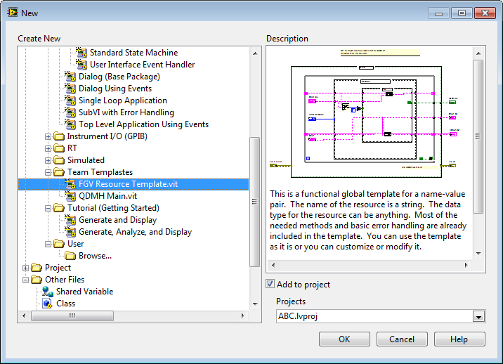
Distribute Common Design Patterns to the Template Browser
Save a VI as a .vit to create a template. Save it to … LabVIEW/Templates so that the template will be displayed in the templates browser.

Slide 42
Template Example: Name Value Lookup Table
Implementing a name value lookup table is a common task in any application. Data is stored and later retrieved by using a naming convention to access the data.
Can be used to store:
References (User Events, DVRs, etc)
Information about devices
Paths for data storage
Operator information
Name | Password
John | 66ford90
Mary | spring2012
Array of names has corresponding array of data
Notes:
Reusable components:

Slide 43
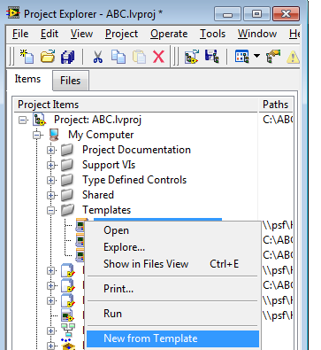
Step 1: Create New Template From The .vit
Note: The behavior of the .vit file is different in the Windows explorer. In windows, double clicking on the .vit will open a new VI from the template. In LabVIEW you must right click on the template in the project and select New from Template to create the new file from the template. Double clicking on the .vit in the project will open the template for editing.

Slide 44
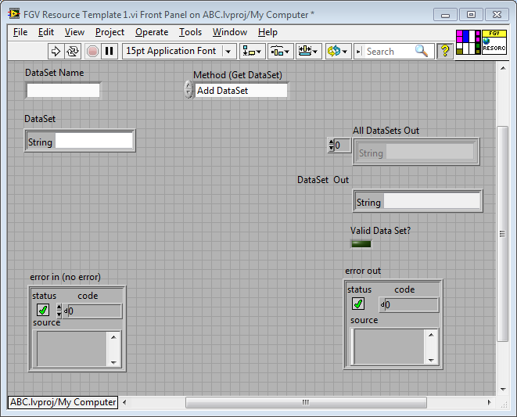
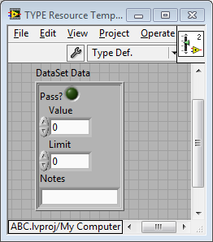
Step 2: Edit the Data That Will be Referenced by the Name
Open a new type def from the front panel of the template and edit for the new module.

Slide 45
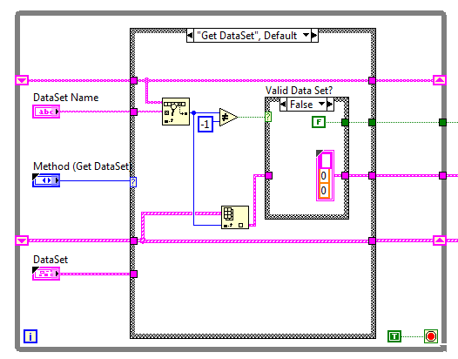

Step 3: Save the VI and Use It In Your Application
Start using the new module, leveraging the benefits of code that has already been tested.

Slide 46
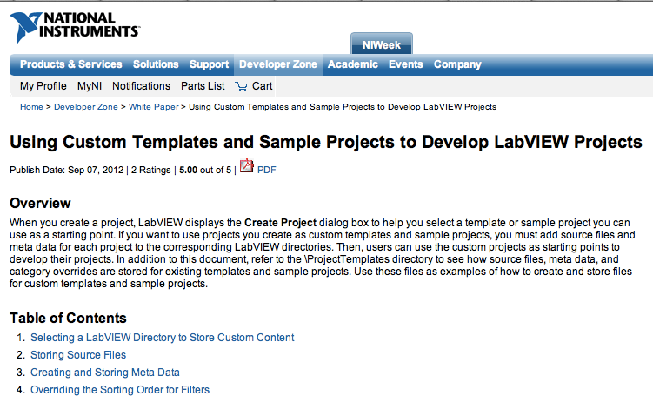
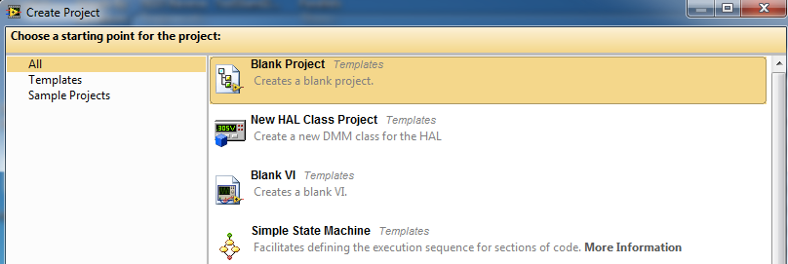
Add Custom Templates
Customer Template

Slide 47
LabVIEW and The Software Engineering Process
Requirements Gathering
Application Architecture
Development
Testing and Validation
Deployment
NI Requirements Gateway
Design Patterns and Ref. Arch.
Graphical Diff
Now Included with DevSuite
LabVIEW Unit Test Framework
Application Builder
SCC
Object Orientation
LabVIEW
VI Analyzer
Real Time/FPGA
Documentation
VIPM
Architecture Review
Coding Standards
LabVIEW Desktop Execution Trace
Notes:
Point of this slide
We understand software engineering and we have tools to help
This is a simplified depiction of the software engineering process (there are a bunch!)
People are successful in this process without these tools – they exist to improve and automate existing practices
A process model prescribes specific phases and tasks to accomplish during the development process. While there are many representations of the software engineering ‘process,’ including the waterfall model, the spiral process model, or more contemporary models such as agile or XP (extreme programming) models, perhaps one of the most common and rigorous, the ‘v-model.’
If you look closely at this diagram you’ll notice that it begins with the defining of requirements for the product. These are often high level and are often developed through discussion with the customer or end-user.
One thing to realize is that the level of criticality directly impacts how granular you have to be in this process. You may not need to spend any formal time architecting your application or the specific modules of code, but these are typically very important for large, complex systems.
There are several SEP models, such as Waterfall, Spiral and Agile, but they all share common ground in terms of having these various phases and tasks that have to be completed. Many companies today are leaning more towards increasingly agile methods. Basically, this means that for many it’s unrealistic to abide by a waterfall method, in which you work on a particular phase, then agree that you’re done and move on. In reality, complex applications require a lot of back and forth between these different phases. For example, something in the prototype stage doesn’t work as expected and therefore require a new definition for how a particular part of the application will operate, thereby impacting requirements documentation and other components such as the test framework. We’ll look at how to address some of these common challenges in just a few slides..
You might note that this does not include prototyping, which is an important part of the development process, but not included in this discussion. For many software vendors, prototyping has very close ties to the requirements phase, as the prototyping lends itself towards a better understanding of what the final product will do. We’ll discuss that further when we talk about requirements management.

Slide 48
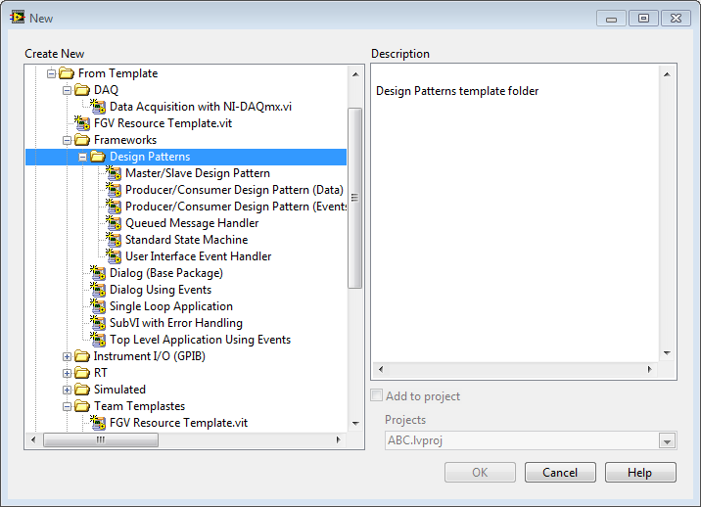
#5 Leverage Standard Design Patterns
These are excellent entry points for learning about how LabVIEW works. They will be the foundation for more fully functional design patterns and templates.

Slide 49
Master Key Design Patterns and Understand Limitations
Master the QMH and the FGV
Multi-
Target
Apps
3-Icon
Apps
State
Machines
Parallel
Apps
Effort
Ability

Slide 50
Inter-Process Communication
Use a Queued Message Hander template for each process.
Use Queues and FGVs for inter-process communication.
This is the beginning and essential for better understanding other communication options.
Inter-process Communication
Store, Stream, Send message?
Process A
Process B

Slide 51
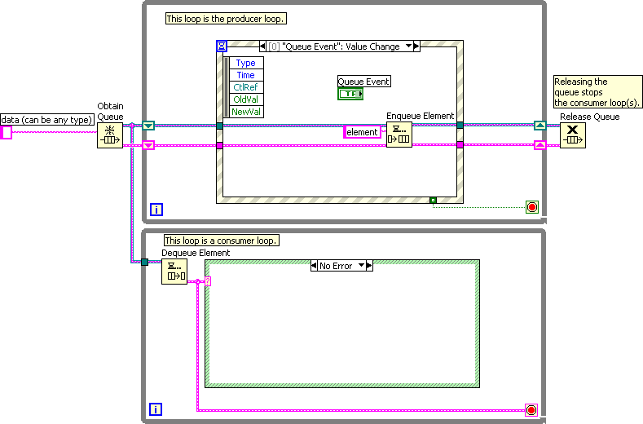
Queued Message Handler (QMH): Based on Producer/Consumer (Events)
Efficiently responds to the user interface
Divide commands into categories
Producer handles immediate response
Consumer handles extended processing
Notes:
You already conducted a thorough evaluation of the Producer/Consumer (Events) design pattern, but you are now going to see how this pattern plays a very foundational role in the primary templates that will be used by your team.

Slide 52
Producer/Consumer (Events): Needs To Be Extended To Be a Useful Template
Encapsulate Queue VIs into SubVIs
Develop error handing code
Develop exit strategy
Change constant to control
Add standard cases, such as Startup, Error, and Shutdown
Notes:
You already conducted a thorough evaluation of the Producer/Consumer (Events) design pattern, but you are now going to see how this pattern plays a very foundational role in the primary templates that will be used by your team.

Slide 53
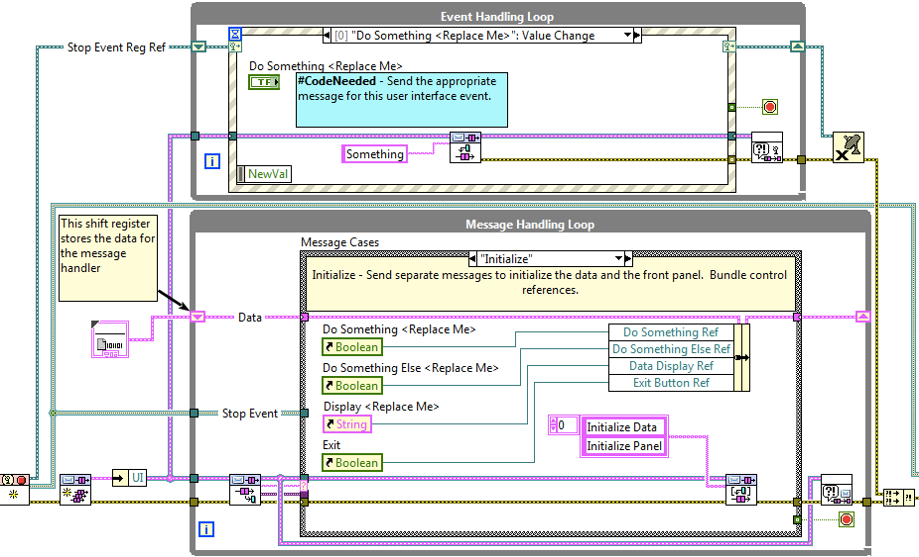
2013 Queued Message Handler – Effectively Extends Producer/Consumer
SubVIs
Handle errors
Exit strategy
Controls
Standard cases

Slide 54
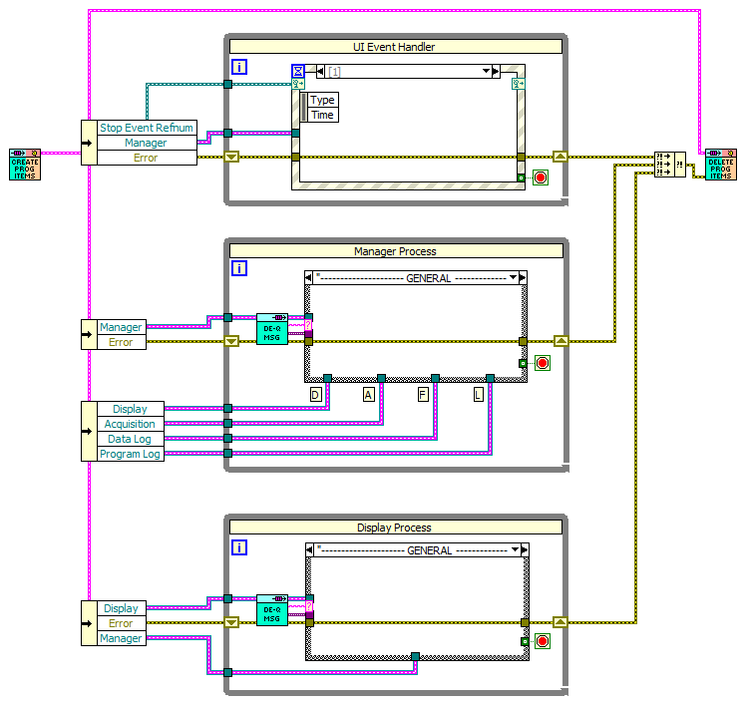
ML-QMH Basic Diagram
Create
Queue
Refs
Event
Destroy
Queue
Refs
Get
Refs
Get
Refs
Manager
Get
Refs
Other #1
Get
Refs
Other #2
.
.
.
.
.
.

Slide 55
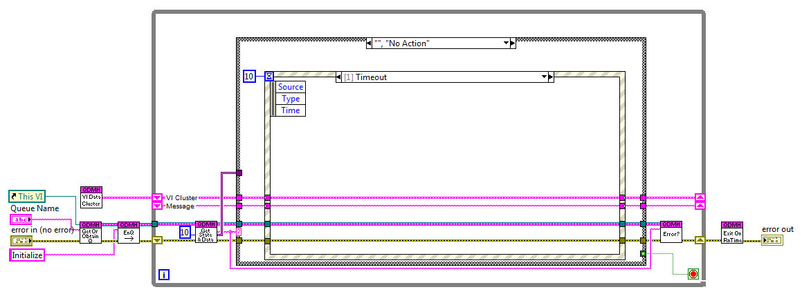
QMH Variation #1 – QDMH Main.vi (Advanced Architectures in LabVIEW Course)
Polymorphic VIs add flexibility.
One loop is used, which simplifies passing data to the event structure and eliminates the need for user events.
Only Queues are used. Does not use User Events.

Slide 56
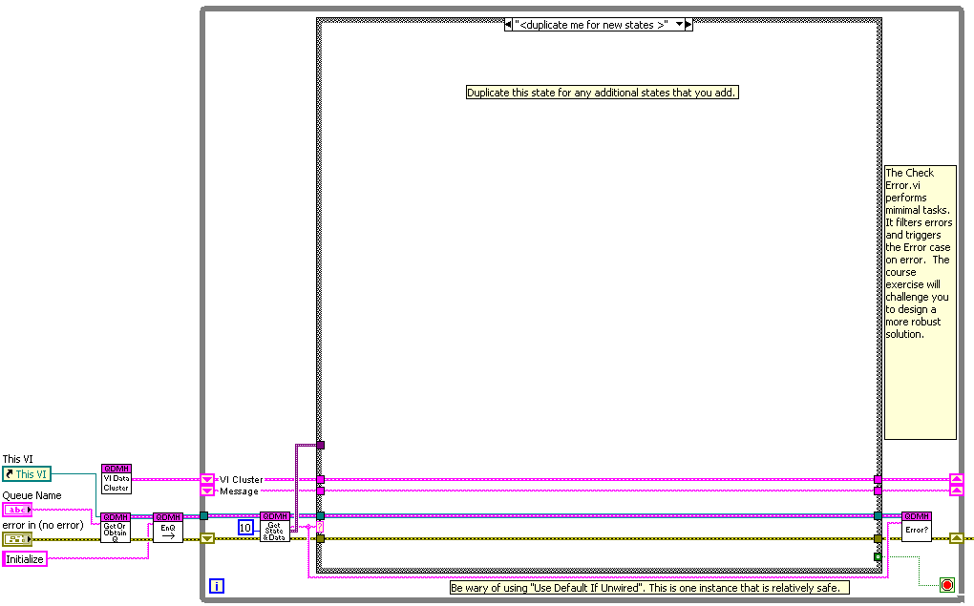
Queue-Driven Message Handler Design Considerations
One loop or two?
Data type for the Queue element?
One shift register or many?
Enum or String ?
Notes:
Queue-Driven Message Handler – Implementation
The following slides explore each of these design questions. Many solutions and options fall under the umbrella of best practices. It is incumbent upon you, the developer, to determine the design choice that best fits your team and software requirements.

Slide 57
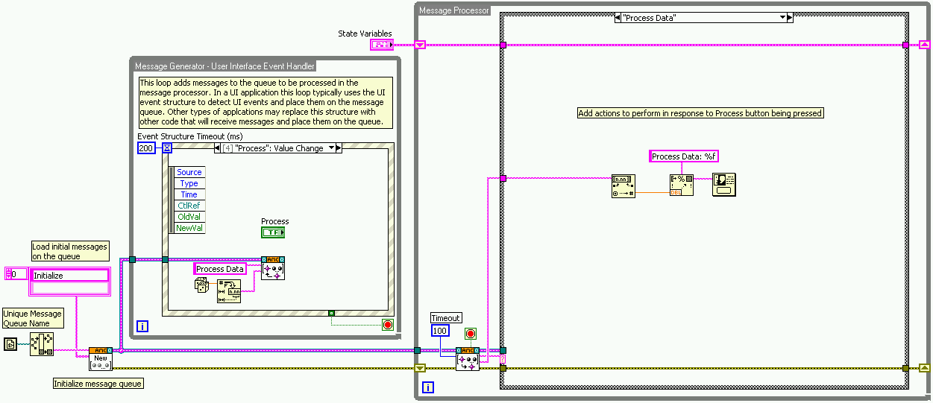
QMH Variation #2– Asynchronous Message Communication (AMC) Reference Library
Download from NI.com
Includes examples and templates
Communicates across the network.
Notes:
QDMH Implementation – Asynchronous Message Communication (AMC) Reference Library
You can download the most recent version of this reference library from the Asynchronous Message Communication (AMC) Reference Library developer zone document on www.ni.com. This document also describes in detail how to use the reference library to implement a Queued Message Handler.

Slide 58
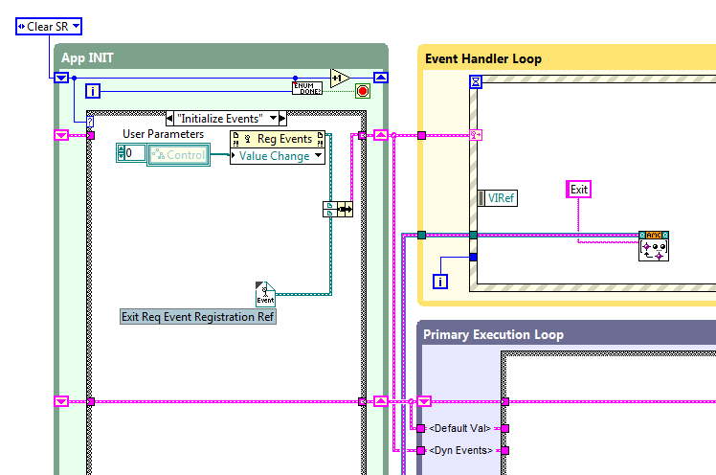
QMH Variation #3 – Top Level Baseline
Available from lavag.org
Extensive feature additions
Same building blocks
Reference design from NI

Slide 59
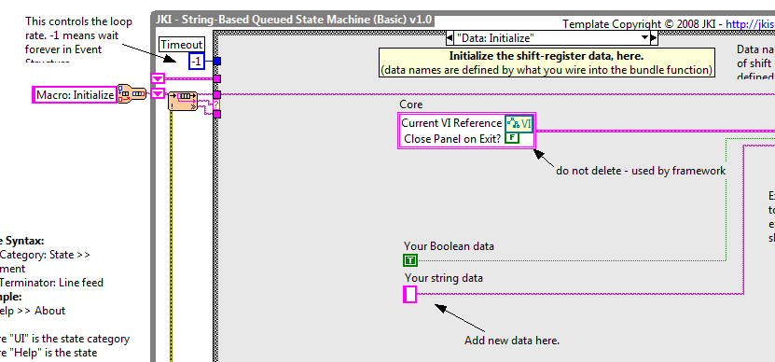
QMH Variation #4 – JKI State Machine
www.ni.com/LabVIEWtools
Additional information at jki.net (Beyond State Machines)
Uses only User Events

Slide 60
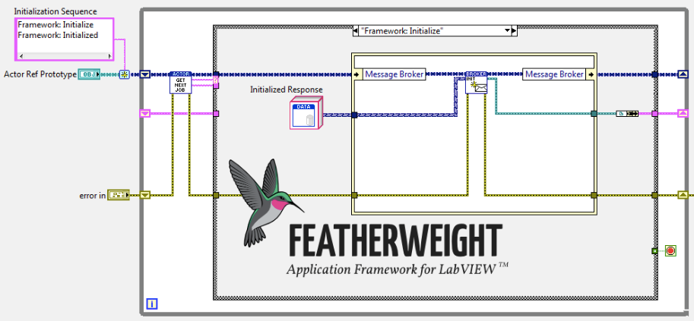
#5 from Wirebird Labs in Q4 2014
Architecture and Connectivity Outside LabVIEW!!!

Slide 61
Issues with Named Queues – Protecting a Process
External.vi
Main.vi
External Process
Message Handler
Main Process
Instead of allowing an external process to have direct access to the Main QDMH queue…
Consider adding code that manages the inbound messages and determine the safe and appropriate time to enqueue the message on the Main QDMH.

Slide 62
Other Common Design Issues
Deadlocks
Race conditions
Timing related bugs
(Incomplete shutdown)
Excessive coupling
Missed messages
Design the QMH to avoid common issues

Slide 63
Store Data
Data is stored and made “globally” accessible
Storage mechanism holds only the current value
Other code modules access the data as needed
The potential for race conditions must be considered
UI Process 1
Headless
Process 1
Headless
Process N
Use Cases
Configuration data Slowly changing data Non-critical messages
“Global Data”
Notes:
By comparison, consider typical messaging mechanisms such as queues. These types of data communication implementations invoke some type of action. When an element is enqueued, the dequeue will immediately run, receiving the message with a command to process. In the classic producer/consumer design pattern, the producer loop will cause an action to occur in the consumer loop.
In contrast, global data storage is simply a memory location that stores data. Any process that needs the data must fetch the data. As such some type of polling would be required for regular retrieval of the data.

Slide 64
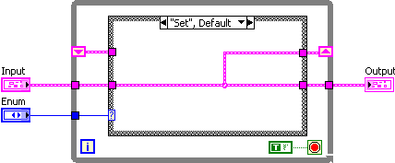

Functional Global Variables
A functional global variable usually has an action input parameter that specifies which task the VI performs
The VI uses an uninitialized shift register in a While Loop to hold the result of the operation
Notes:
This is information straight out of core 1

Slide 65

Best Practices for Documentation
The action/method control should be a type defined enum.
Make “get” the default action/method.
Consider making the action/method required.
Include this in the label.
Wire to the top connector
Notes:
The developer of the FGV or action engine wants to avoid the situation in which the someone uses the FGV, forgets to wire the method and then accidentally changes the state of the FGV. Making the “get” method the default prevents this. Additionally, making the method/action a required terminal will force the user to specifically wire to the input as well.

Slide 66
Functional Global Variables – History
(LV2 Style Global, Action Engine, VIGlobals, USRs, Components)
Global data storage mechanism prior to the introduction of the global variable in LabVIEW 3
Foundational programming technique that has been in extensive use in the LabVIEW community
Note: The behavior of an uninitialized shift register was not defined in LabVIEW 1.0
Notes:
Functional Global Variables – History
The functional global variable has a fascinating history. Prior to the release of LabVIEW 2, the value of the initialized shift register had not been defined. This was during the time period in which LabVIEW was black and white and required the developer to disconnect all of the terminals to move an icon. With the release of LabVIEW 2, the LabVIEW development team wisely determined that the uninitialized shift register would retain its previous value. The alternative would have been that it revert back to the default value of the data type.
Subsequently, with the release of LabVIEW 2, this technique became the methodology for storing global data in LabVIEW. The native global variable was not introduced until LabVIEW 3. But even with the introduction of the native global variable, the functional global variable remained a popular programming technique for global data storage.

Slide 67


Replacing Global Variables with FGVs
This is a common initial use case.
Notes:
The overly simplified message that reaches to LabVIEW community is “don’t use globals, use functional globals to prevent race conditions.” However, as we shall see, it’s not just the functional global encapsulation that prevents the race conditions. So let’s evaluate what this simple set & get functional global provides us.

Slide 68

FGV – Action Engine Protects Critical Sections of Code
FGV Counter.vi
Get
Modify
Set
This action engine wraps the “get/modify/set” around the critical section of code.

Slide 69
FGV – Resource Storage
Design pattern for a key-value look up table.
Array of names has a one-to-one correspondence to the array of data sets
Does not protect against race conditions
Allows for the qualification of valid data

Slide 70

What if You Need Multiple Counters…
Reentrant functional global?
Array manipulation of the functional global data?
Perhaps there is a better way…
?

Slide 71


What is the Data Value Reference (DVR)?
This is a simple way to wrap a reference around any type of data.
Create & Destroy
Modify

Slide 72



Creating a DVR from an FGV
If you already have an FGV, you can easily transform it into the more flexible DVR library.
Create the constructor and destructor.
Create a method (VI) for each case that was in the FGV.

Slide 73


Data Value Reference (DVR) - Library
Reference acts as a pointer to the data
Create unlimited instances
Easily expand the library

Slide 74
Inter-Process Communication
Typically straightforward use cases with limited implementation options
Store
Stream
Send (Data and/or Messages)
Many more variations and permutations, many design considerations

Slide 75
#6 – Harness the Power of Object Oriented Programming
Terminology:
An object is like a cluster, but with special abilities.
A class defines what data is in the cluster and the operations that can be performed on that data.
You may hear objects referred to as instances of the class. That is, each object on a wire is a separate instance of the cluster defined by the class.
Notes:
Object Oriented Programming
Object—The object is the entity that exists at runtime. In the case of LabVIEW, it is essentially a cluster, but a cluster that has special characteristics. Analogously, consider a neighborhood. The object is the house that actually exists.
Class—The Class could be considered the blueprint of the house. It describes the house and its properties once it has been created.
Instances of the Object—The instances would be each house that is on the block or neighborhood that was created (or instantiated) based on the blueprint.

Slide 76
Object Oriented Programming
Terminology:
The operations defined by the class are called methods. In LabVIEW, these are VIs.
The class file is another specialized library file, like the XControl and the project library we have already seen. Like all libraries, the class collects together a group of related VIs.
In this case, the VIs collectively define a new data type.
All VIs that are part of the class are called member VIs. Member VIs may be any type of VI (standard, control, global, etc). The methods are the standard VIs that can be executed.
Notes:
Object Oriented Programming
Methods—Method is an object oriented term. In LabVIEW it refers to the VIs that operate on the private class data.

Slide 77



LVOOP Basics – Creating a Class
Step 1
Step 2
Step 3
Notes:
LVOOP Basics – Creating a Class
The steps to creating a LabVIEW class and understanding the benefits of encapsulation are quite simple. All you need to do is create the class, define the data members just as you would for any type def cluster, then add the Methods (or VIs) to modify the data. Additionally you should build a Test VI for your class.
Step 1
Create a new class from the template browser. Or go to the project explorer right-click My Computer and select New»Class.
You should also save your class in a new folder.
Step 2
Double-click the *.ctl file to open the Customize Control editor. Define your cluster elements here.
Notice that the typical control types (Control, Type Def and Strict Type Def) are not available. This is a special type called Class Private Data.
Step 3
Add methods to the class. Right-click the *.lvclass and select New»VI from Static Dispatch Template. Navigate the block diagram of the newly created VI. You can access the data in the object through the unbundle by name function. Add code and controls and indicators as needed. Modify the connector pane for the newly created controls and indicators. Save the method in the folder that you created when you first saved the class.

Slide 78


LVOOP Basics – Encapsulation and Libraries
Report.ctl. is Class Private Data – it is “private” and can only be accessed by a Method that is a Member of the class.
Notes:
LVOOP Basics – Encapsulation and Libraries
Recall the discussion about libraries in Lesson 3. For any type of library, including XControls, you can make VIs in the library private. As such those VIs can only be called by another VI that is in the library. Placing a private VI in a block diagram of a VI that is outside the class will cause that VI to be broken. The same holds true for class data or the class object. Notice the icon displayed on the *.ctl in the class or project explorer. It is the red “private” key. As such only VIs in the class can access

Slide 79

LVOOP Basics – Encapsulation
Limited Access to the Data
Notes:
LVOOP Basics – Encapsulation
The encapsulation benefit is quite evident when you attempt to unbundle the elements of an object. Only VIs that are part of the class can unbundle the class data. All other VIs, those that are not part of the class, will be broken if an unbundle or unbundle by name is wired to the object. You can think about a LVOOP object as a glorified cluster.

Slide 80


Migrating to OOP
For those who choose object designs, we want wire and node to morph naturally into class and method .
– Stephen Mercer
Report Class
Object
Method
Notes:
Migrating to OOP
In essence, encapsulation protects data. Protecting data means that only a limited number of VIs have access to the data structure. This data structure is a cluster that is defined by the developer or architect and it can contain any combination of elements. It is more secure than a simple type def. When you create a cluster that is a type def, you achieve the ability to ensure that all instances of the cluster will be updated when the type def is modified. Though this provides an enormous benefit to the developer, the data is still exposed. Any section of code that touches that cluster could modify it through the unbundle or unbundle by name functions. One small change in the data structure could introduce bugs or errors through out an application. As such, the architect or developer can greatly benefit from a feature that not only provides the benefit of the type def, but also protects the data such that a limited number of VIs can modify the data in the cluster.
Easy to teach and use
The ability to create these classes was introduced in LabVIEW 8.2 and since that time has been gaining wide acceptance. More and more code distributed with LabVIEW, or available at ni.com, is being developed with LVOOP. As such, it is becoming increasingly important for a LabVIEW development team to have at least a cursory understanding of this technique.
One of the benefits of LVOOP is that it is very easy for a novice developer to use and understand the VIs associated with a LVOOP class. They function just as a normal cluster functions. The only difference is that the developer must use the class Methods to access the data.

Slide 81


Encapsulation – Simplifies Debugging
Without LVOOP With LVOOP
How many VIs access the cluster? How long could it take to find the source of the bug?
Only the method VIs touch the data. The developer’s search for the source of the error narrows significantly.
Notes:
Encapsulation – Simplifies Debugging
On substantial benefit of LVOOP is that it isolates the search area for detecting potential bugs. The only VIs that can access the class data are the methods that are part of the class. Subsequently, when a problem occurs, the developer does not have to explore the entire hierarchy of an application. Instead, the developer simply needs to focus on the class itself to determine the source of the erroneous data.

Slide 82

Inheritance – Dynamic Dispatch
In essence, dynamic dispatch is polymorphism at runtime…
The object type determines which VI is dispatched at runtime.
Notes:
Inheritance – Dynamic Dispatch
The real power behind LVOOP is the implementation of inheritance, in particular dynamic dispatch. Essentially, dynamic dispatch is run-time polymorphism. Essentially the wire is intelligent and determines the dynamic VI what will operate on it at run time. Fully understanding inheritance, how to implement it in LabVIEW, and how to leverage it in an application requires and investment. Additionally a full explanation is beyond the scope of this course. However, you will be exposed to the basics and experience the benefits of making this investment.

Slide 83

Inheritance – Class Hierarchy
Notes:
Inheritance – Class Hierarchy
We are family
The term “inheritance” clearly describes the relationship that must exist in order for a group of VIs to take advantage of dynamic dispatch. Essentially, a single parent and many children form a group of related classes. The siblings all “inherit” both data and methods from the parent. For now we will focus on inheriting methods.
What is a family?
Many members make up the Jones family. Each child is a “Jones.” Similarly we have a Report family. A TDMS report is a report. And XML report is a report. So in the Report class there is a method called Write to File. Each of the siblings: TDMS, TXT, and XML will have a unique implementation for writing the file. As such, the architect has designed the write to file as a dynamic dispatch method. Subsequently, an application can then be written in which the file format is uncertain until run time. Then at run time, the report wire will be intelligent. It will be either a TDMS Report object, a TXT Report object, or an XML Report object. The nature of that object will then determine the dynamic method to execute at run time.

Slide 84


Roundtrip Tools for OO Code Generation
GOOP Development Suite from Symbio
(both available on www.ni.com/LabVIEWtools)

Slide 85

The Lagoon – Check Your English
has a
has a
uses a
is a

Slide 86
Class Diagram Terminology
Inheritance
One class “is a” more specific instance of another class.
Aggregation
One class “has a” instance of a class as part of it’s class private data.
Association
A class “uses” another class.
86

Slide 87
Class Diagram Terminology - Boats
Inheritance
A motor boat “is a” boat
Aggregation
A boat “has a” GPS device
Association
A GPS device “uses a” satellite
87

Slide 88
The Lagoon
has a
has a
uses a
is a

Slide 89

Design Guidelines

Slide 90
LabVIEW and The Software Engineering Process
Requirements Gathering
Application Architecture
Development
Testing and Validation
Deployment
NI Requirements Gateway
Design Patterns and Ref. Arch.
Graphical Diff
Now Included with DevSuite
LabVIEW Unit Test Framework
Application Builder
SCC
Object Orientation
LabVIEW
VI Analyzer
Real Time/FPGA
Documentation
VIPM
Architecture Review
Coding Standards
LabVIEW Desktop Execution Trace
Notes:
Point of this slide
We understand software engineering and we have tools to help
This is a simplified depiction of the software engineering process (there are a bunch!)
People are successful in this process without these tools – they exist to improve and automate existing practices
A process model prescribes specific phases and tasks to accomplish during the development process. While there are many representations of the software engineering ‘process,’ including the waterfall model, the spiral process model, or more contemporary models such as agile or XP (extreme programming) models, perhaps one of the most common and rigorous, the ‘v-model.’
If you look closely at this diagram you’ll notice that it begins with the defining of requirements for the product. These are often high level and are often developed through discussion with the customer or end-user.
One thing to realize is that the level of criticality directly impacts how granular you have to be in this process. You may not need to spend any formal time architecting your application or the specific modules of code, but these are typically very important for large, complex systems.
There are several SEP models, such as Waterfall, Spiral and Agile, but they all share common ground in terms of having these various phases and tasks that have to be completed. Many companies today are leaning more towards increasingly agile methods. Basically, this means that for many it’s unrealistic to abide by a waterfall method, in which you work on a particular phase, then agree that you’re done and move on. In reality, complex applications require a lot of back and forth between these different phases. For example, something in the prototype stage doesn’t work as expected and therefore require a new definition for how a particular part of the application will operate, thereby impacting requirements documentation and other components such as the test framework. We’ll look at how to address some of these common challenges in just a few slides..
You might note that this does not include prototyping, which is an important part of the development process, but not included in this discussion. For many software vendors, prototyping has very close ties to the requirements phase, as the prototyping lends itself towards a better understanding of what the final product will do. We’ll discuss that further when we talk about requirements management.

Slide 91
# 7 – Engage in Code Reviews
Performing a Code Review - Informal
Walk someone through your code
Questions to consider:
Is the code easy to maintain, and has it been documented?
What happens if the code returns an error?
(… or if it receives an error?)
Is too much functionality located in a single VI?
Are there any race conditions?
Is the memory usage within acceptable limits?
Perform code reviews frequently
Notes:
Let’s start off by describing just what a code review is. When you perform a code review, which is sometimes referred to as a code walk, you taking someone through your code and explaining how it works.
There’s an expression about code reviews that goes - “The best code reviews are the ones that actually get done.” Any attempt to review your code is going to beneficial.
The idea behind a code review is that in having another set of eyes look at your code will help you find problems, but, in fact, most issues discovered during a code review are identified by the developer while explaining how everything.
Once you feel the code is ready to reviewed, meaning you think it is finished, you have to choose your reviewer. This is an important consideration because you need to choose someone who understands LabVIEW and can give constructive, sound feedback. It’s not effective to choose a reviewer who only understands C because too much time is spent explaining the principles behind LabVIEW.
In our LabVIEW R&D groups, we have a general rule of thumb that we use: for bug fixes or relatively minor new features and changes, it’s OK for a peer to review the code. For new programs or major new features, the group manager will perform the code review.
Once you sit down with your reviewer to walk through your code, you’re going to show them the main path through your code and answer any questions that they may have. Remember that your code should be reflective of the agreed-upon design, the discussion should focus primarily on the architecture of the code (i.e. state machine, producer/consumer, etc.). Some of the topics that may be discussed include how easy the architecture of the code makes it to add a new feature or makes changes, how errors are reported and handled, and whether the code is modular enough. If global or local variables are used, you should explain how you have eliminated the possibility of race conditions. You can also demonstrate that the code doesn’t starve the processor or use a prohibitive amount of memory.
Overall, you’re showing your reviewer that you’ve created clean, robust code that will achieve the requirements set out much earlier in the SW development cycle.
And now Eric, who is representing R&D today, is going to demonstrate the type of code review that you would find in LabVIEW R&D here at NI.

Slide 92
Engage in Code Reviews
Performing a Code Review – Formal
Send code to all of the reviews
Each review goes through the code documenting issues in a defined format
Coder holds a meeting with all of the reviewers with the purpose of compiling issues, not solving them.
After solving the issues the team reconvenes to confirm that issues have been addressed.

Slide 93
Leverage an Issue Tracking System
Even if the actual review process is more informal, an issue tracking system can be essential:
Many issue tracking software solutions exist.
A simple spreadsheet works for small groups.
Ensure that you capture: the date that issues were added, who added the issue, the priority, and the resolution.

Slide 94
Preparing for a Code Review
Don’t forget…
Add descriptions and block diagram documentation
Eliminate performance issues and race conditions
Use programming style chosen by your organization
Preparation can be automated using VI Analyzer
Eliminate as many problems as possible BEFORE the review!
Notes:
Documentation makes the code easier for others (and you!) to understand later.
Add instructions to your front panel
Add free labels to your block diagram to document the algorithms that you use
Add a description to the VI properties.
Identify any issues with the performance of your code.
Memory Usage – Avoid coercion dots and minimize new memory buffer allocations
Processor Usage – Use Event structures to monitor front panel, add Wait functions to While Loops to free processor resources
Race Conditions – Use local and global variables sparingly
In Lesson 2: Requirements Gathering, we discussed the creation of style and coding standards. The code review is an ideal opportunity to ensure that the standards that were established have been followed.
Many of these checks can be automated by using VI Analyzer, which we will discuss in greater depth later.

Slide 95
Establish or Adopt Development Guidelines
Front Panel Style
Fonts and Text Characteristics
Colors
Graphics and Custom Controls
Layout
Sizing and Positioning
Labels
Paths versus Strings
Enumerated Type Controls versus Ring Controls
Default Values and Ranges
Property Nodes
Key Navigation
Dialog Boxes
Style Checklist
VI Checklist
Front Panel Checklist
Block Diagram Checklist
Block Diagram Style
Wiring Techniques
Memory and Speed Optimization
Sizing and Positioning
Left-to-Right Layouts
Block Diagram Comments
Call Library Function Nodes and Code Interface Nodes
Type Definitions
Sequence Structures
Icon and Connector Pane Style
Icons
Example of Intuitive Icons
Connector Panes
(www.LabVIEWJournal.com)
Notes:
This list illustrates just some of the many different items and criteria that it’s important to screen for during a code review. There are many more, and many that are specific to certain types of applications and hardware targets.
National Instruments coordinates thousands of developers around the world that are developing applications in a variety of different languages, including LabVIEW. As a result, code reviews are an important part of this process, but we use tools to help identify potentially problematic areas that require additional attention.

Slide 96


Preparing for a Code Review with VI Analyzer
Automate code analysis with 80+ configurable tests
Performance
Style
Complexity
Interactively inspect failures
Generate custom reports
Code complexity metrics
Write your own tests with VI Scripting LabVIEW 2010
Notes:
In order to simplify the process, you need to take advantage of tools that can help automate the code inspection and help identify improvements. One example is the LabVIEW VI Analyzer tool, which is an add-on for LabVIEW 7 and 7.1 that analyzes any LabVIEW code and then steps the user through the test failures. You can also generate reports that allow you track code improvements over time, and can be checked into source code control software along with your VIs.
Static code analysis refers to any tool or method that has pre-established criteria by which it can compare source code to see if it meets standards for style, organization and technique. This can be performed prior to, or even without, compilation or execution of the application.
Thanks to the release of VI Scripting, it’s now possible to create your own VI Analyzer test.

Slide 97

Community Support
https://decibel.ni.com/content/docs/DOC-28198

Slide 98



#8 Perform Dynamic Code Analysis with the Desktop Execution Trace Toolkit
External application that interfaces with LabVIEW
Comes with the Developer Suite
Can analyze code in an .exe and across the network!

Slide 99


Desktop Execution Trace Toolkit
Trace During Run-Time:
Event Structures
Memory Allocation
Queues / Notifiers
Reference Leaks
Thread ID
Unhandled Errors
Dynamic / Static SubVIs
Custom User Strings
Notes:
While all of the mentioned use-cases are appropriate, it is perhaps the most useful to know exactly what you’re looking for or where you’re looking for it. This makes it easier to sort through the information to find details that can help address your specific concern.
Problems such as memory leaks can have costly consequences for systems that are required to sustain operation for extended periods of time or for software that has been released to a customer. If software that needs debugging has been deployed and the LabVIEW development environment is not installed on the current machine, it may be beneficial to perform dynamic analysis of the code with the Desktop Execution Trace Toolkit over the network. For deployed systems, even if the development environment is available, it may be impractical or difficult to locally troubleshoot or profile the execution of a running system.

Slide 100
#9 Ensure App Is Regularly Tested by Someone Else
Begin this process early in the development cycle.
Write test harness for integration testing.
Consider writing test harness before coding.
Nothing else needs to be said.
(Note: The nature of LabVIEW is that early in the LabVIEW programming career, the developer is often also the customer. That may change over time.)

Slide 101





LabVIEW Unit Test Framework
Windows Desktop
Input Values
Output
VI Under Test
Unit Test
Framework
Expected Output
Automated
Report Generation
Test vector = Input value(s) + Expected output(s)
Notes:
Runs on Windows

Slide 102


Programmatic Unit Testing
Programmatically invoke testing and report generation
Notes:
Point out that these tests can be invoked and run programmatically. This is especially useful when combined with programmatic build processes. This palette is installed with the toolkit. It also allows us to open the results dialogue and create a report.

Slide 103
#10 – Participate in Local and Global Community
Participate in regional LabVIEW User Group meetings
Attend LabVIEW Developer Day events in various cities.
Attend CLD Summits and CLA Summits.
Attend NIWeek
Let David Bonal know that we want a CLD Summit in ABQ in Oct. 2014

Slide 104

LabVIEW Communities at NI.com
Join existing communities or create your own.
Don’t miss:
LabVIEW APIs
Reference Designs
UI
Large Apps
Quick Drop

Slide 105

Where Can You Go for More Code and Ideas?
www.lavag.org
More Than A Message Board
A Community of Avid LabVIEW Programmers
A Place to Learn About New Technologies
A Place to Shape the Future of LabVIEW
Notes:
Where Can You Go for More Code and Ideas?
The crew at LAVA throws a great BBQ at NIWeek, engages in interesting discussions about the fifth dimension, and enjoys general wackiness in the LAVA lounge. Yes, you can post questions and get answers.
Most importantly you can follow many interesting threads about new advanced design patterns in LabVIEW. Follow the comments from Aristos Queue to get the last word on LVOOP. Follow interesting discussions on the new DVR feature. Investigate new advanced design patterns such as LVx and Message Pump (based on LVOOP). Shape the form of the new LVOOP based error handling tools.

